Slide 1
CONVOLUTIONAL NEURAL NETWORKS and RECURRENT NEURAL NETWORKS
Introduction to Coding for Data Science week 10:
CONVOLUTIONAL NEURAL NETWORKS and RECURRENT NEURAL NETWORKS
Prof J.W. Muteba Mwamba

Slide 2
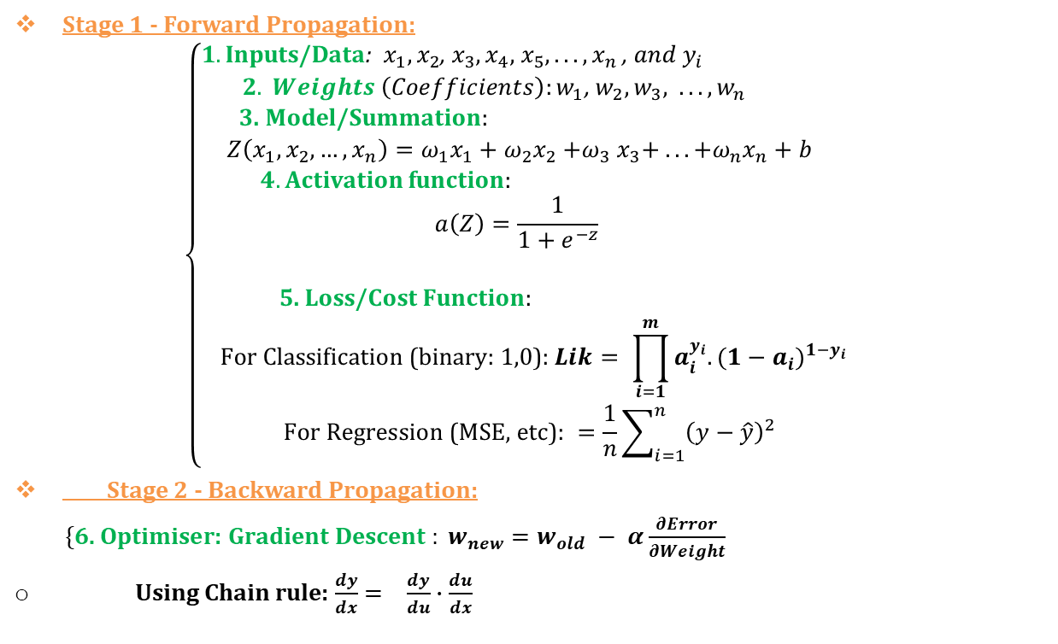
Deep Learning Set Up:
Stage 1 - Forward Propagation:
$$\left\{\begin{aligned}1. \text{Inputs}\text{/}\text{Data}\text{: }x_{1},x_{2}\text{, }x_{3},x_{4}\text{, }x_{5}, . . . , x_{n} \text{,} and y_{i} \\ 2. Weights \left(Coefficients\right):w_{1}\text{, }w_{2},w_{3}\text{, } . . . , w_{n} \\ \text{3. }\text{Model}\text{/}\text{Summation}\text{: } \\ Z\left(x_{1},x_{2}, …,x_{n}\right)=ω_{1}x_{1}+ω_{2}x_{2}{+ω}_{3}x_{3}+ . . . +ω_{n}x_{n}+b \\ 4. \text{Activation} \text{function}\text{:} \\ a\left(Z\right)=\frac{1}{1+e^{−z}} \\ \\ \text{5. }\text{Loss}\text{/}\text{Cost} \text{Function}\text{:} \\ \text{For} \text{Classification}\text{ (}\text{binary}\text{: 1,0): }Lik= \prod_{i=1}^{m}{a_{i}^{y_{i}}.(1−a_{i})^{1−y_{i}}} \\ \text{For} \text{Regression}\text{ (}\text{MSE}\text{, }\text{etc}\text{): }{=\frac{1}{n}\sum_{i=1}^{n}{{\left(y−\hat{y}\right)}^{2}}}_{}\end{aligned}\right.$$
Stage 2 - Backward Propagation:
$\left\{\text{6. }\text{Optimiser}\text{: }\text{Gradient} \text{Descent} \right.: w_{new}=w_{old} − α\frac{∂Error}{∂Weight}$
Using Chain rule: $\frac{dy}{dx}= \frac{dy}{du}∙\frac{du}{dx}$

Slide 3
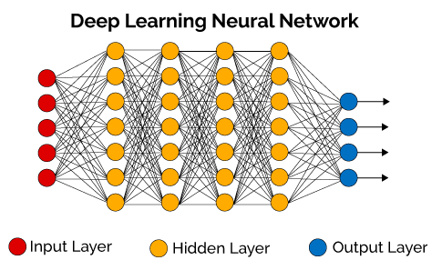
Deep Learning Architecture: Fully Connected Layers: Input-layer (Numerical or Categorical Variables), Hidden Layers, Output Layer

Slide 4
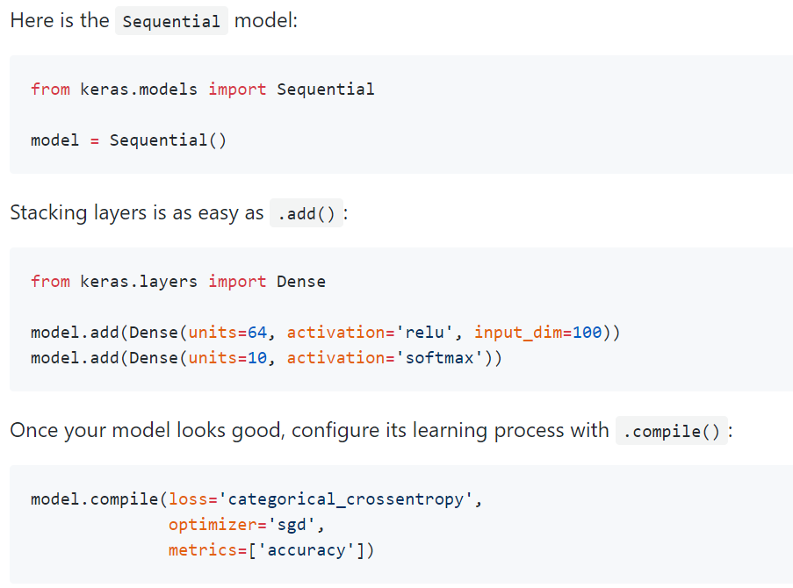
Code Structure: Sequential model with Keras library

Slide 5
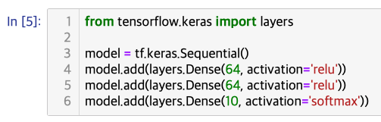
Code structure - Example with Tensorflow

Slide 6
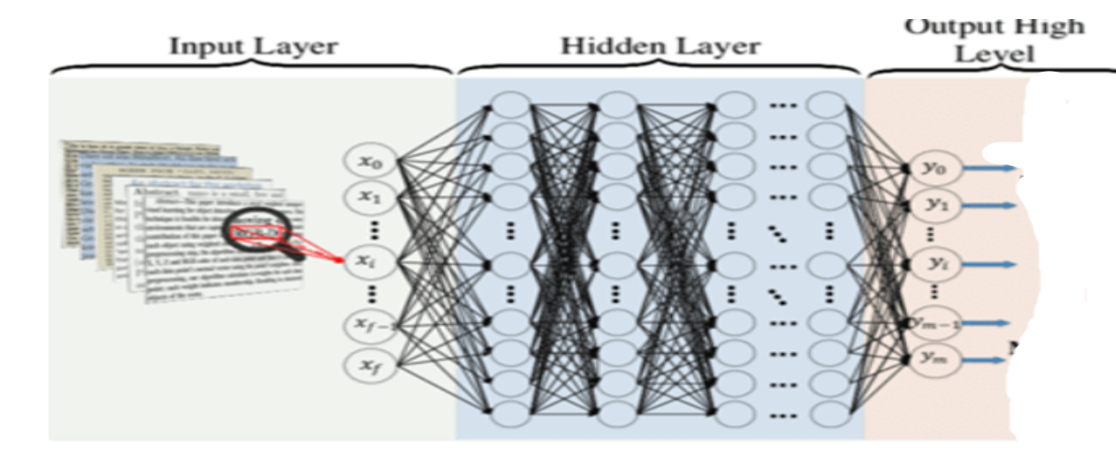
Deep Learning Architecture for Textual Data
When input are textual data

Slide 7
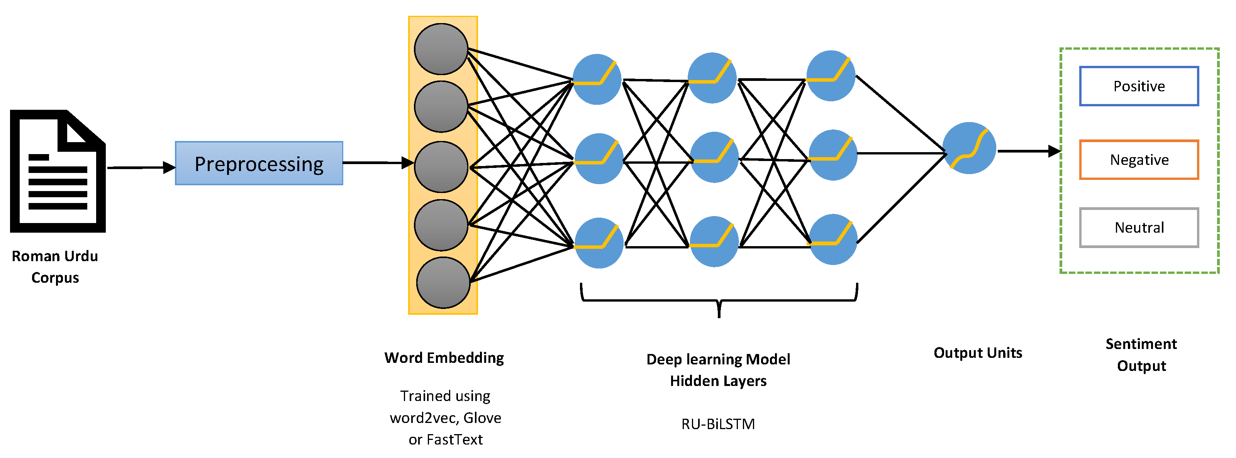
DL Architecture for Textual Data: input-Layer, Embedding Layer, Fully connected Layer(s)
Pre-process textual data using vectorization methods: BoW, TF-IDF, Word embedding (Word2Vec) i.e. CBoW or Skip-gram

Slide 8
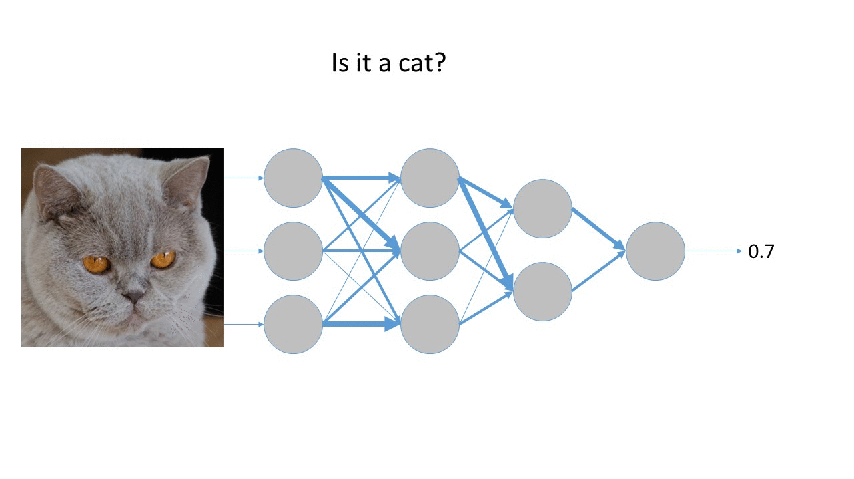
Deep Learning Architecture for Image Data
Image recognition

Slide 9
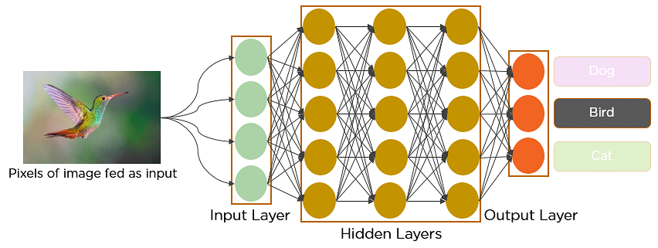
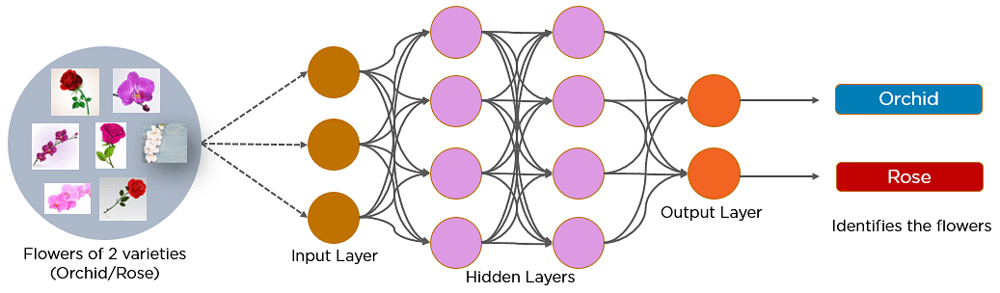
Deep Learning Architecture for Image Data
Image recognition

Slide 10
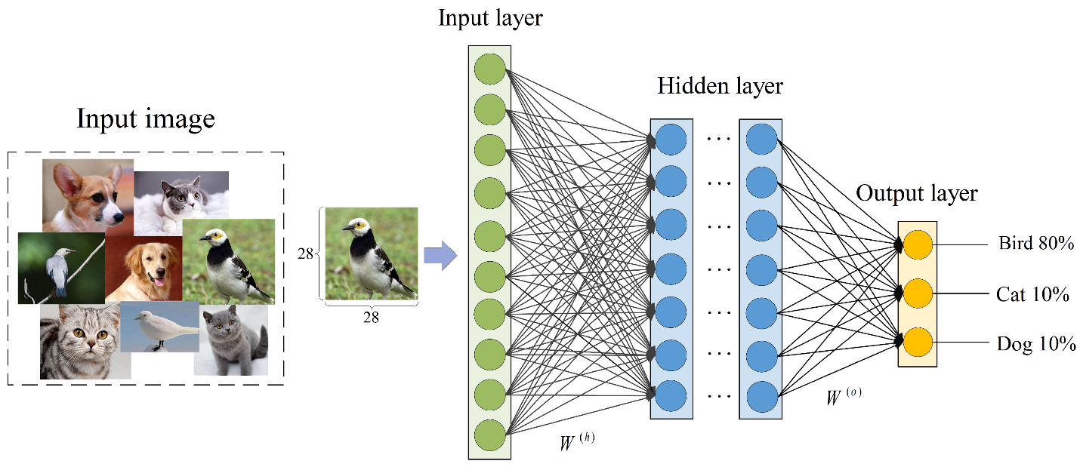
Deep Learning Architecture for Image Data
Computer Vision

Slide 11
CONVOLUTIONAL NEURAL NETWORK
A Convolutional Neural Network (CNN or ConvNet) is a deep learning algorithm specifically designed for image recognition, image classification, image detection, and image segmentation.
It is used in real-life applications, such as self-driving cars, surveillance cameras, and more.
Unlike traditional machine learning models like SVM and decision trees that require manual feature extractions, CNNs can perform automatic feature extraction, making them efficient.
Convolutions layers can recognize patterns from data and extract features regardless of their position, whether the image is rotated, scaled, or shifted.

Slide 12
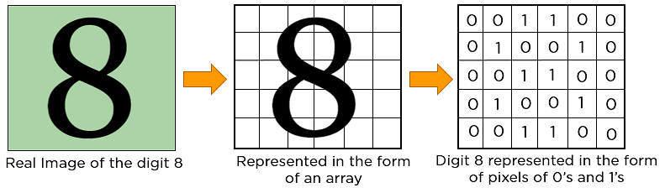
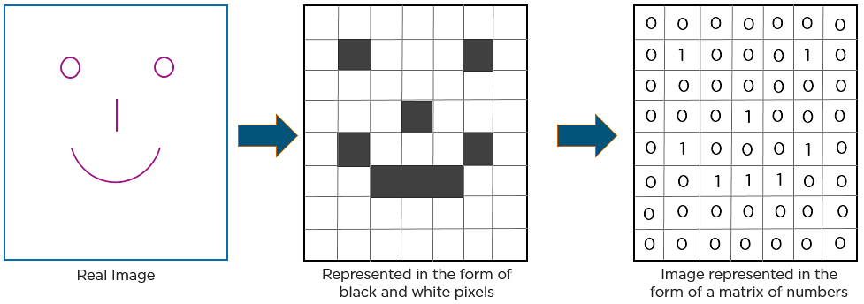
HOW DOES CNN RECOGNISE IMAGES
What computer sees, pixel, tensor

Slide 13
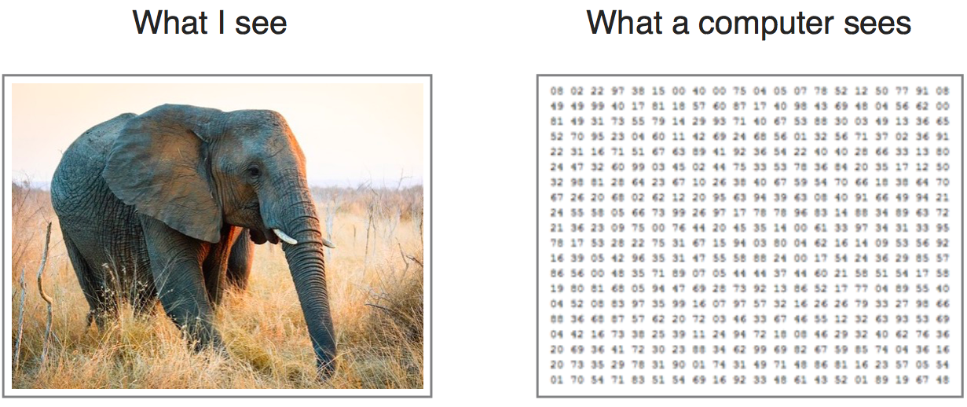
CONVOLUTIONAL NEURAL NETWORK
Image data is divided into pixels. Each of these pixels are denoted as the numerical values called Pixel Values. These pixel values denote the intensity of the pixels.
Pixel values range from 0 to 255. (The smaller numbers closer to zero represent the white shade while the larger numbers closer to 255 represent the darker shade.)
Every image is saved in matrix form also known as a Channel-

Slide 14
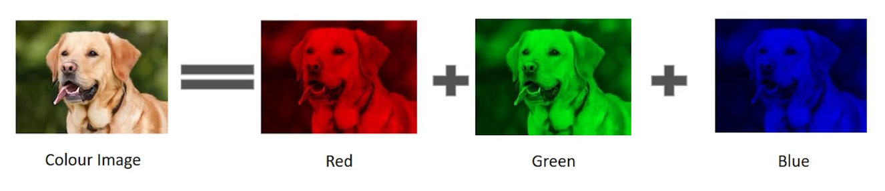
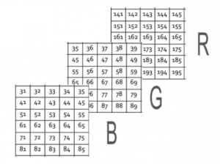
CONVOLUTIONAL NEURAL NETWORK
For colored images: we will assume that any color can be generated from the main three: Red, Green, and Blue (i.e. the RGB channels).
One colored picture can have more than one channels/matrices. In this particular example, we have 3 matrices:

Slide 15
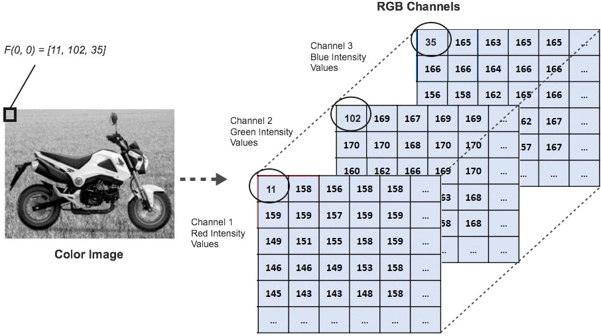
CONVOLUTIONAL NEURAL NETWORK
Example of RGB representation of colored image data is:
NB: What is the dimension of this data:
M*N*d = TENSOR
Hence: a notation of for example: (6000, 28, 28, 3) means we have collected 60000 RGB color images of pixels in 28 by 28.

Slide 16
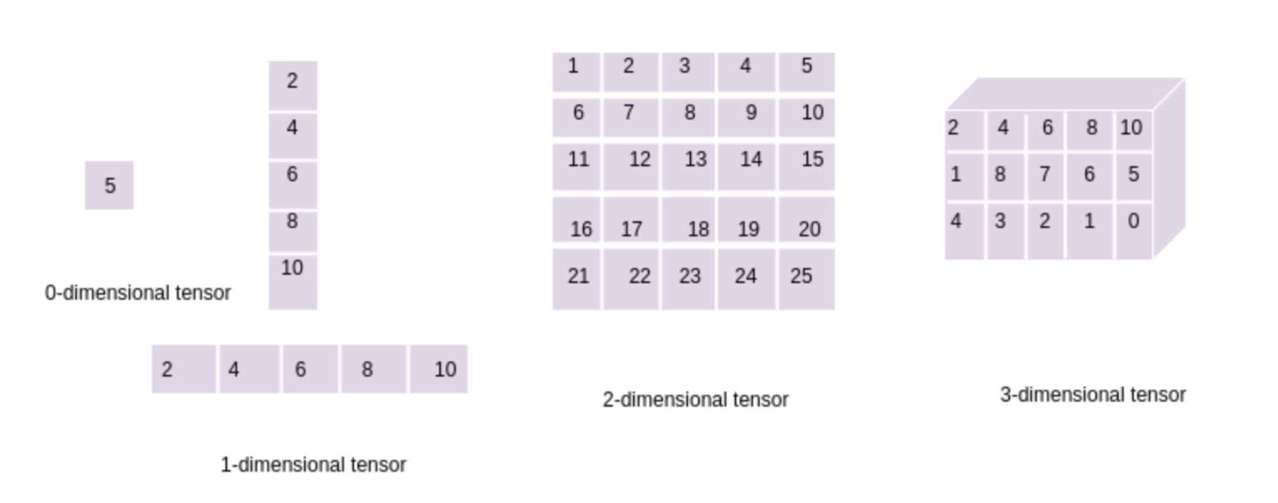
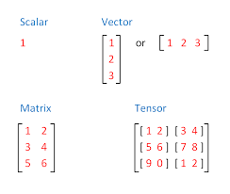
CONVOLUTIONAL NEURAL NETWORK
What is a Tensor?
A tensor is a N-dimensional representation of a dataset in Machine Learning and Deep Learning. A tensor can be a 1-dimensional, a 2-dimensional, a 3-dimensional array, etc.

Slide 17
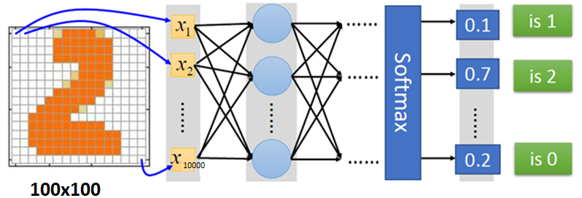
Why Convolutional Neural Network for Image classification?
Assume a 100 × 100 image with 10,000 pixels. If the first layer has just 1,000 ➔10 million connections (just for the first layer).
Deep Learning Networks with several layers would overfit the data

Slide 18
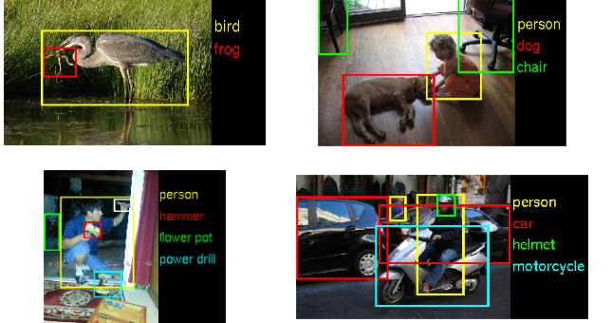
CNN solution
CNNs solve this problem using partially connected layers.
far fewer parameters than a fully connected DNN
reduces the risk of overfitting,
requires much less training data.
heavily reuses its weights,
much faster to train
Identify feature maps➔

Slide 19
Convolutional Neural Network Architecture
CNN is typically composed of following types of layers:
Input Layer
Convolution Layer + Activation Function
Pooling Layer
Fully Connected Layer(s).
Convolution and pooling layers, perform feature extraction,
Fully connected layer, maps the extracted features into final output, such as classification.

Slide 20
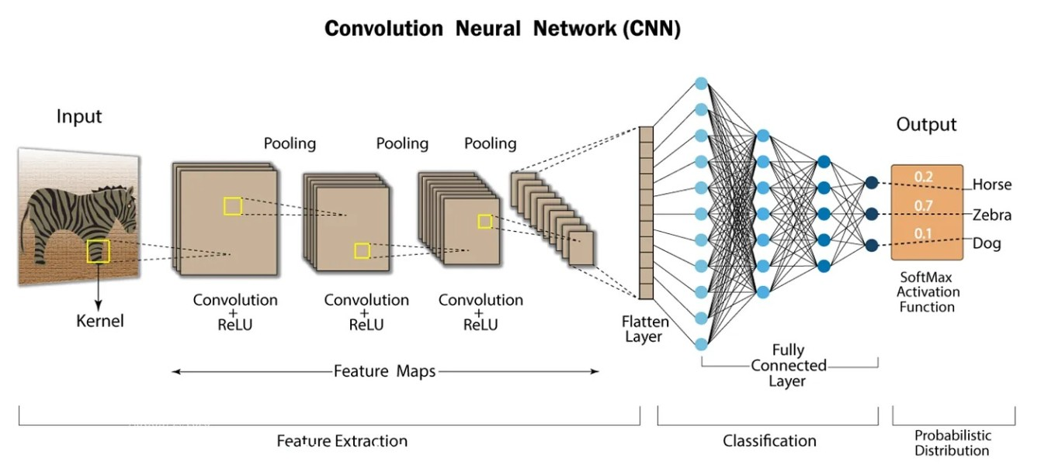
DL Architecture for Image Data: Input-Layer, Convolution-Layer(s), Pooling Layer(s), Flatten-Layer, Fully-Connected-Layer(s), & Output-Layer

Slide 21
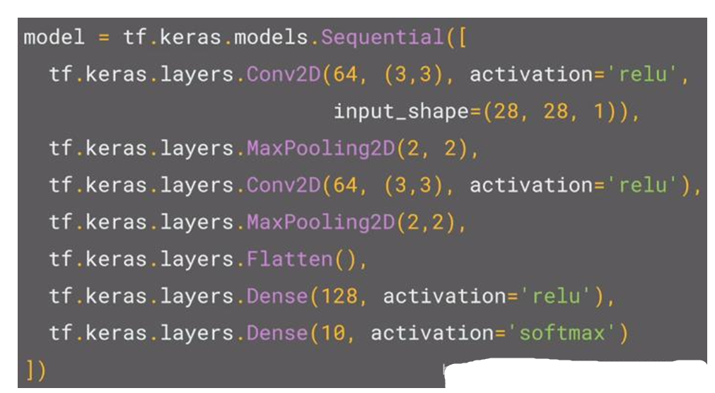
Code Structure: Convolutional Neural Network

Slide 22
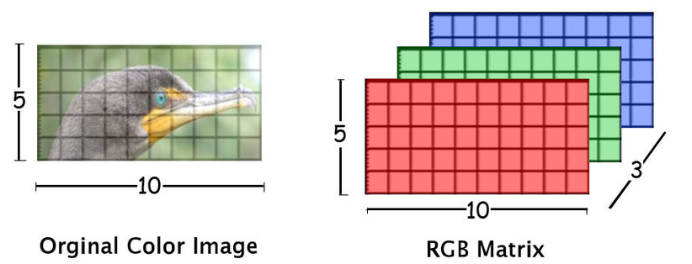
Input Layer
Input image can be Grayscale or RGB.
Every image is made up of pixels that range from 0 to 255. We need to normalize them i.e convert the range between 0 to 1 before passing it to the model.
Input layers are where we load the raw input data of the image.
This input data specifies the width, height, and number of channels.
Typically, the number of channels is three, for the RGB values for each pixel.

Slide 23

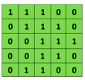
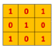
Convolution
Type of linear operation where a small array of numbers, called a kernel, is applied across the input (tensor).
Two key hyperparameters
are size (e.g. 3x3, 5x5 or 7x7) and number of kernels.
The number of kernels determines the depth of output feature maps.
Convolutional
3x3 filter
Input matrix

Slide 24
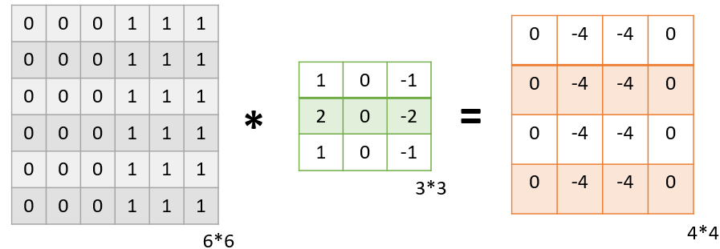
Convolution Layer 1
The convolution layer is the layer where the filter is applied to our input image to extract or detect its features. A filter is applied to the image multiple times and creates a feature map which helps in classifying the input image.
Let’s understand this with the help of an example. For simplicity, we will take a 2D input image with normalized pixels.
Below, we have applied a filter of 3*3 on an input image of size 6*6 to detect some features
NB: In this example, we have applied only one filter but in practice, many such filters are applied to extract information from the image.

Slide 25
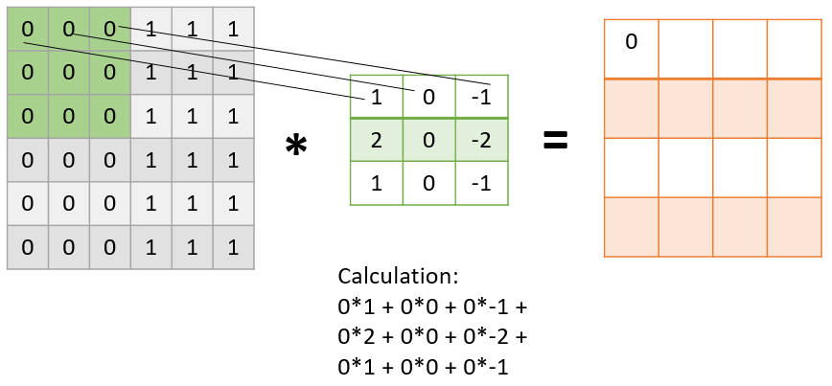
Convolution Layer 2
We obtain a Feature Map (of 4*4) by applying the filter/kernel to the image
in the first step the filter is applied to the green highlighted part of the image, and the pixel values of the image are multiplied with the values of the filter (as shown in the figure using lines) and then summed up to get the final value.

Slide 26
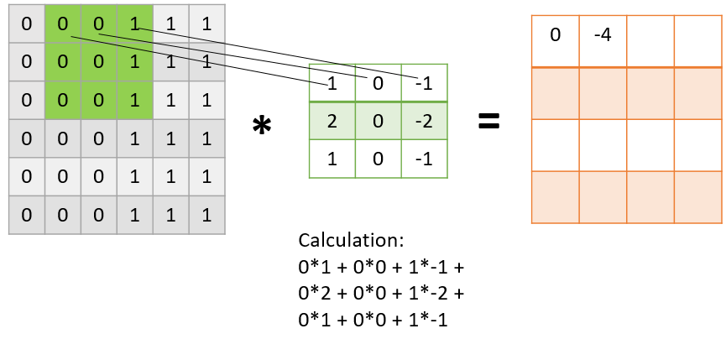
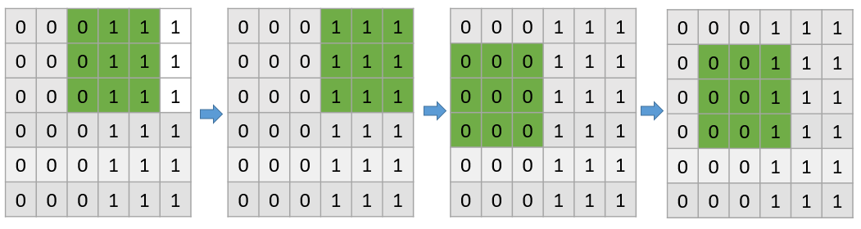
Convolution Layer 3
In the next step, the filter is shifted by one column as shown in the below figure. This jump to the next column or row is known as stride and in this example, we are taking a stride of 1 which means we are shifting by one column.
⬅a filter passes through the entire image with the stride of 1 a stride of 1

Slide 27
Stride
Stride=1
1 | 0 | 0 | 0 | 0 | 1
0 | 1 | 0 | 0 | 1 | 0
0 | 0 | 1 | 1 | 0 | 0
1 | 0 | 0 | 0 | 1 | 0
0 | 1 | 0 | 0 | 1 | 0
0 | 0 | 1 | 0 | 1 | 0
The distance between two successive
kernel positions is called a stride.
Stride configures how far our sliding filter
window will move per application of the
filter function.
As the stride value goes up, the output
volume spatially goes down.
It’s been demonstrated that smaller
strides (e.g., 1) in convolutional layers
work better in practice.
A stride larger than 1 is sometimes
used in order to achieve down-sampling
of the feature maps.
Stride=2
1 | 0 | 0 | 0 | 0 | 1
0 | 1 | 0 | 0 | 1 | 0
0 | 0 | 1 | 1 | 0 | 0
1 | 0 | 0 | 0 | 1 | 0
0 | 1 | 0 | 0 | 1 | 0
0 | 0 | 1 | 0 | 1 | 0

Slide 28
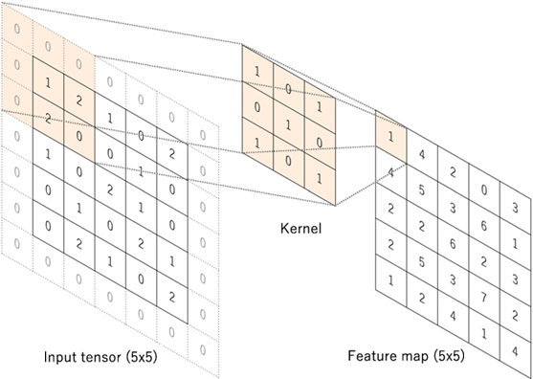
Zero padding
Zero padding to retain in-plane dimensions in order to apply more layers.
Zero-padding preserves input information along the borders.
Padding notation:
Valid: It means no padding.
If we are using valid padding,
the output will be smaller.
Same: Here, we apply padding
so that the output size is the
same as the input size.

Slide 29
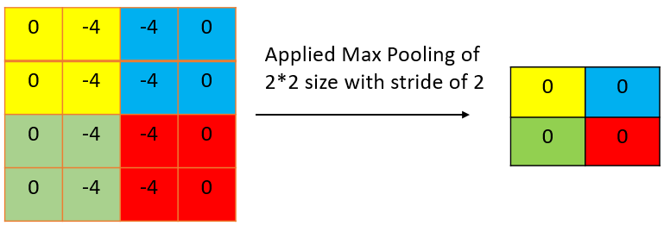
Pooling Layer
The pooling layer is applied after the Convolutional layer to reduce the dimensions of the feature map for fast computation
The most common types of Pooling are Max Pooling and Average Pooling.
The below figure shows how Max Pooling works. Using the Feature map which we got from the above example to apply Pooling. Here we are using a Pooling layer of size 2*2 with a stride of 2.
The maximum value from each highlighted area is taken and a new version of the input image is obtained which is of size 2*2 so after applying Pooling the dimension of the feature map has reduced.

Slide 30

Fully Connected Layer (s) 1
The Fully connected layer is used for classifying the input image into a label. This layer connects the information extracted from the previous steps (i.e Convolution layer and Pooling layers) to the output layer and eventually classifies the input into the desired label.
Hence, the complete process of a CNN model can be summarized as:

Slide 31
Fully Connected Layer (s) 2
The output feature maps of the final convolution or pooling layer is typically flattened, i.e., transformed into a one-dimensional (1D) array of numbers (or vector), and connected to one or more fully connected layers, also known as dense layers, in which every input is connected to every output by a learnable weight.
We use this layer to compute class scores that we’ll use as output of the network (e.g., the output layer at the end of the network).

Slide 32
CNN Hyper-Parameters
Layer | Parameters | Hyperparameters
Convolution layer | Kernels | Kernel size, number of kernels, stride, padding, activation function
Pooling layer | None | Pooling method, filter size, stride, padding
Fully connected layer | Weights | Number of weights, activation function
Others |  | Model architecture, optimizer, learning rate, loss function, mini-batch size, epochs, regularization, weight initialization, dataset splitting

Slide 33
Image augmentation: Adding rotated images to sample data
To make the model more size-invariant, we can add different sizes of the image to the training set.
To make the model more rotation-invariant, we can add images with different angles (add rotated images to dataset).
This also helps to avoid overfitting. Overfitting happens when a model is exposed to very few samples.

Slide 34
.
CODING CNN IN PYTHON

Slide 35
RECURRENT NEURAL NETWORK
RNNs are called recurrent because they perform the same task for every element of a sequence, with the output depending on the previous values.
RNNs have a “memory” which captures information about what has been calculated so far.
In theory RNNs can make use of information in arbitrarily long sequences.

Slide 36
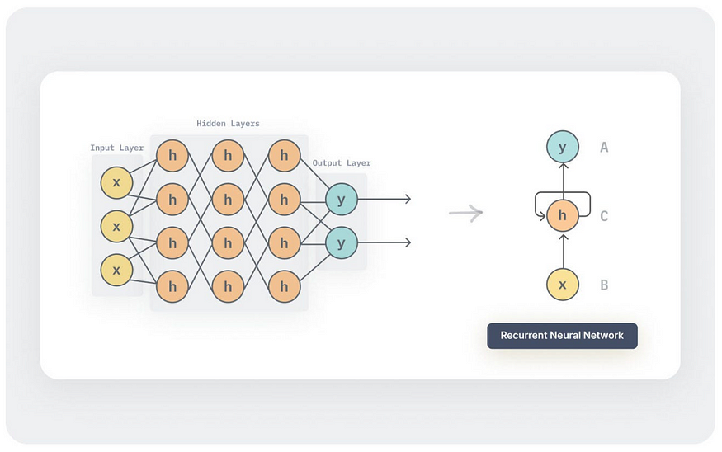
Recurrent Neural Networks Architecture
The basic architecture of an RNN is shown below.

Slide 37

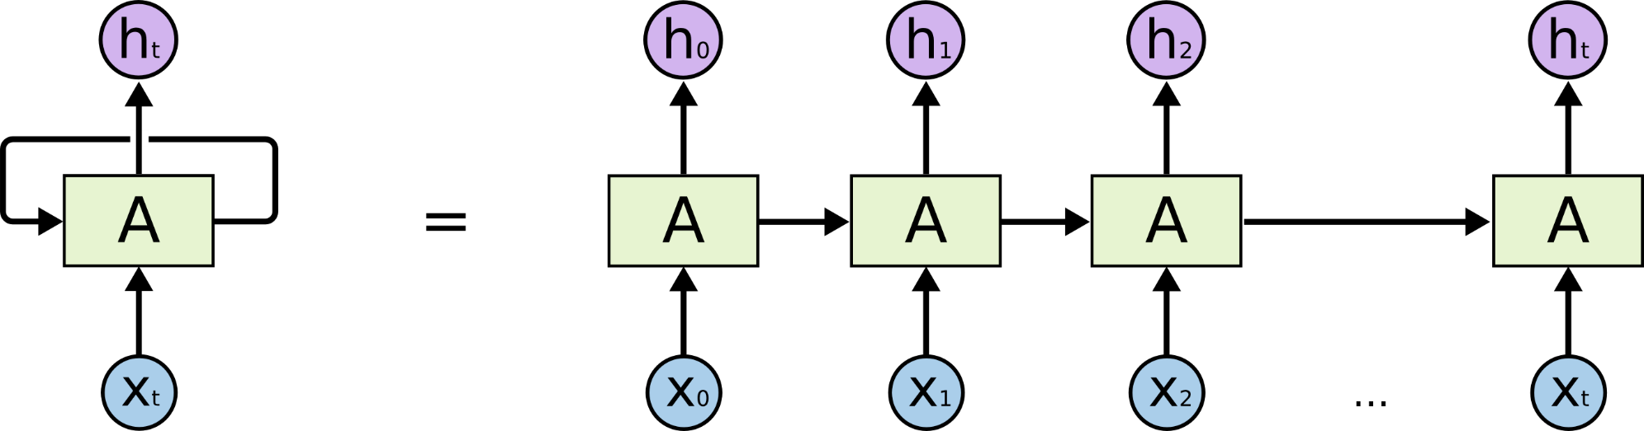
Recurrent Neural Network

Slide 38
Hidden Units
The hidden state s_{t} represents the memory of the network.
s_{t} captures information about what happened in all the previous time steps.
The output o_{t} is calculated solely based on the memory at time t.
s_{t} typically can’t capture information from too many time steps ago.
Unlike a traditional deep neural network, which uses different parameters at each layer, a RNN shares the same parameters (U, V, W above) across all steps.
This reflects the fact that we are performing the same task at each step, just with different inputs. This greatly reduces the total number of parameters we need to learn.

Slide 39
RNN Pro/Cons
RNN Advantages:
Can process input of any length
Model size doesn’t increase for longer input
Computation for step t can (in theory) use information from many steps back
Weights are shared across timesteps → representations are shared
RNN Disadvantages:
Recurrent computation is slow
In practice, difficult to access information from many steps back

Slide 40
How do RNN reduce complexity?
h and h’ are vectors with the same dimension
Given function f: h’, y = f(h, x)
y₁
y₂
y₃
h₀
f
h₁
f
h₂
f
h₃
……
x₁
x₂
x₃
No matter how long the input/output sequence is, we only need one function f.
If f’s are different, then it becomes a feedforward NN.

Slide 41
Deep RNN
RNNs with multiple hidden layers
y₁
y₂
y₃
y₄
y₅
y₆
x₁
x₂
x₃
x₄
x₅
x₆
Slide by Arun Mallya

Slide 42
Bidirectional RNN
RNNs can process the input sequence in both forward and reverse direction
y₁
y₂
y₃
y₄
y₅
y₆
x₁
x₂
x₃
x₄
x₅
x₆
Popular in speech recognition and NLP

Slide 43
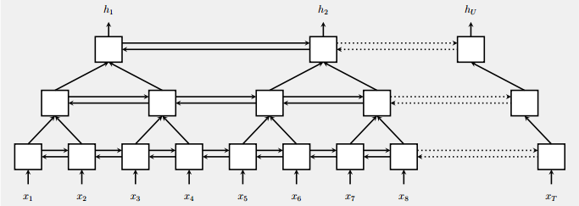
Pyramid RNN (not covered in this lecturer)
Significantly speed up training
Reducing the number of time steps
Bidirectional
RNN
W. Chan, N. Jaitly, Q. Le and O. Vinyals, “Listen, attend and spell: A neural network for large vocabulary conversational speech recognition,” ICASSP, 2016

Slide 44
Vanilla RNN
y
h'
W
^{h}
U
x
= σ ( + + β
h
f
h'
y
V
^{h’}
= σ( )
x
Note, y is computed from h’

Slide 45
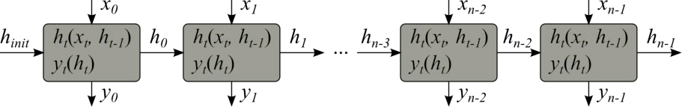
Vanilla RNN
h_{t} = σ(W_{ih} x_{t} + U h_{t−1} + b)
y_{t} = σ(W₀ h_{t})
Unfolding the network in time

Slide 46
RNN Training
RNN Training

Slide 47
RNN Training
Target: obtain the network parameters that optimize the cost function Cost functions: log loss, mean squared root error etc…
Tasks:
For each timestep of the input sequence x predict output y (synchronously)
For the input sequence x predict the scalar value of y (e.g., at end of sequence)
For the input sequence x of length L_{x} generate the output sequence y of different length L_{y}
Methods
Backpropagation:
Others:
Reliable and controlled convergence
Supported by most of ML frameworks
Evolutionary methods, expectation maximization, non-parametric methods, particle swarm optimization
Research Ideas!

Slide 48
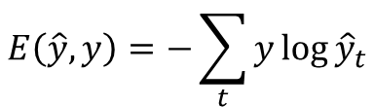
Back-propagation Through Time Method
h_{t} = σ(W_{ih} x_{t} + U h_{t−1} + b)
y_{t} = σ(W₀ h_{t})
_{Cross Entropy Loss:}
Unfold the network.
Repeat for the train data:
Given some input sequence 𝒙
For t in 0, N-1:
Forward-propagate
Initialize hidden state to the past value 𝒉_{𝑡−1}
Obtain output sequence 𝒚
Calculate error E(y, y)
Back-propagate error across the unfolded network
Average the weights
Compute next hidden state value 𝒉_{𝑡}

Slide 49
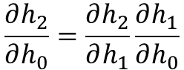
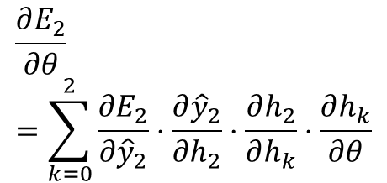
Back-propagation Through Time
y₀
E₀
y₁
E₁
y₂
E₂
ŷ₀
ŷ₁
ŷ₂
h_{init}
Timestep 0
h₀
Timestep 1
h₁
Timestep 2
h₂
x₀
x₁
x₂
Apply chain rule:
For time 2:
𝜽 - Network parameters

Slide 50
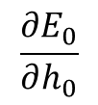
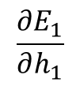
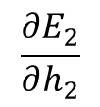
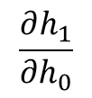
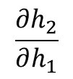
Back-propagation Through Time
E₀
E₁
E₂
y₀
y₁
y₂
ŷ₀
ŷ₁
ŷ₂
h_{init}
Timestep 0
h₀
Timestep 1
h₁
Timestep 2
h₂
x₀
x₁
x₂

Slide 51
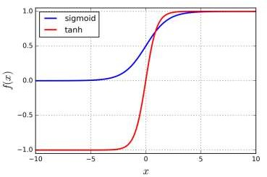
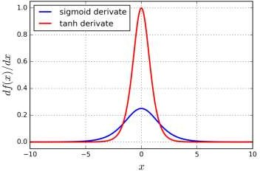
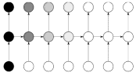




Problem: vanishing gradients
Gradient close to 0
Saturation
Saturated neurons gradients → 0
𝝏𝒉_{𝑡}
𝝏𝒉_{𝑡}
𝝏𝒉₃ 𝝏𝒉₂
=
∙ ⋯ ∙
∙ ∙
𝝏𝒉₁
𝝏𝒉₀
^{𝝏𝒉}𝑡−1
𝝏𝒉₂ 𝝏𝒉₁ 𝝏𝒉₀
Drive previous layers gradients to 0
(especially for far time-steps)
Decays exponentially
Network stops learning, can’t update
Impossible to learn correlations between temporally distant events
Known problem for deep feed-forward networks.
For recurrent networks (even shallow) makes impossible to learn long-term dependencies!
Smaller weight parameters leads to faster gradients
vanishing:
Very big initial parameters make the gradient descent to diverge fast (explode).

Slide 52
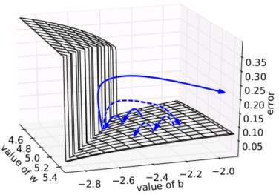
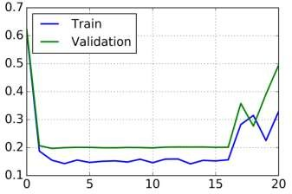
Problem: exploding gradients
Large increase in the norm of the gradient during training
Diagnostics: NaNs; Cost function large fluctuations
Pascanou R. et al, On the difficulty of training recurrent neural networks. arXiv (2012)
Network can not converge and
weight parameters do not stabilize
Solutions:
Use gradient clipping
Try reduce learning rate
Change loss function by setting constrains on weights (L1/L2 norms)

Slide 53
Problems with Vanilla RNN
When dealing with a time series, it tends to forget old information.
When there is a distant relationship of unknown length, we wish to have a “memory” to it.
Vanishing gradient problem.

Slide 54
LSTM (Long Short Term Memory)
LSTM (Long Short Term Memory)

Slide 55

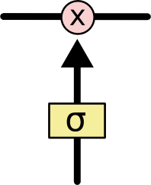
LSTM Architecture – Arrows used!
The sigmoid layer outputs numbers between 0-1 determine how much
each component should be let through. Pink X gate is point-wise multiplication.

Slide 56
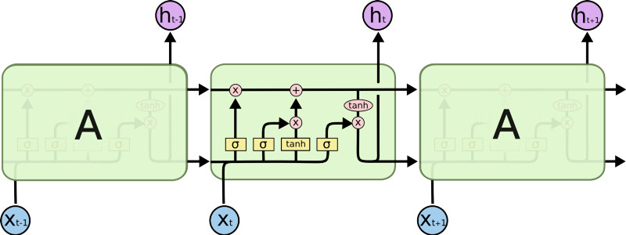

LSTM Architecture
Output gate
Controls what
goes into output
This sigmoid gate
determines how much
information goes thru
This decides what info
Is to add to the cell state
C_{t-1}
h_{t-1}
Forget input
gate gate
The core idea is this cell state C_{t}, it is changed slowly, with only minor linear interactions. It is very easy for information to flow along it unchanged.
Why sigmoid or tanh:
Sigmoid: 0,1 gating as switch.
Vanishing gradient problem in
LSTM is handled already.
ReLU replaces tanh ok?

Slide 57





LSTM Architecture
.
i_{t} decides what component
is to be updated.
C’_{t} provides change contents
Updating the cell state
Decide what part of the cell
state to output

Slide 58

RNN vs LSTM

Slide 59
LSTM – Forward/Backward
Explore the equations for LSTM forward and backward computations:
Illustrated LSTM Forward and Backward Pass

Slide 60
Information Flow in a LSTM
z
W
x^{t}
= tanh( )
h^{t-1}
These 4 matrix
computation can
be done concurrently.
x^{t}
z^{i}
W^{i}
= σ( )
c^{t-1}
h^{t-1}
Controls
forget gate
Controls
input gate
Updating
information
Controls
Output gate
z^{f}
W^{f}
x^{t}
= σ( )
h^{t-1}
z^{f}
z^{i}
z
zº
zº
x^{t}
Wº
= σ( )
h^{t-1}
x^{t}
h^{t-1}

Slide 61

◉
Element-wise multiply
y^{t}
c^{t-1}
c^{t}
c^{t} = z^{f}  c^{t-1} + z^{i}z
◉
◉
tanh
h^{t} = zº  tanh(c^{t})
◉
y^{t} = σ(W’ h^{t})
z^{f}
z^{i}
z
zº
h^{t-1}
x^{t}
h^{t}
Information flow of LSTM

Slide 62

LSTM information flow
y^{t}
y^{t+1}
c^{t-1}
c^{t}
c^{t+1}
◉
◉
◉
◉
tanh
tanh
z^{f}
z^{i}
z
zº
z^{f}
z^{i}
z
zº
h^{t+1}
h^{t-1}
x^{t}
h^{t}
x^{t+1}

Slide 63
GATED RECURRENT UNIT
Not covered in this lecture!
Skip to:
“Comparison: Feed-forward vs Recurrent Network”

Slide 64

GRU – Gated Recurrent Unit
reset gate
Update gate
It combines the forget and input into a single update gate.
It also merges the cell state and hidden state.
Simpler than LSTM. There are many other variants too.
X,*: element-wise multiply

Slide 65

Both take x_{t} and h_{t-1} as inputs and compute h_{t} to pass along.
GRUs don't need the cell layer to pass values along.
The calculations within each iteration ensure that the h_{t} values being passed along either retain a high amount of old information or are jump-started with a high amount of new information.

Slide 66

How do GRU solve the vanishing gradient problem?
h_{t}
h_{t+1}
h_{t+2}
h_{t+n}
h_{t}
h_{t+1}
h_{t+2}
h_{t+n}

Slide 67
Perhaps we can create adaptive shortcut connections.
Let the net prune unnecessary connections adaptively.
Through the gates mechanism
h_{t}
h_{t+1}
h_{t+2}
h_{t+n}

Slide 68
Comparing: Feed-forward vs Recurrent Network
Feedforward network does not have input at each step
Feedforward network has different parameters for each layer
x
f₁
a¹
f₂
a²
f₃
a³
f₄
y
t is layer
a^{t} = f_{t}(a^{t-1}) = σ(W^{t}a^{t-1} + b^{t})
h⁰
f
h¹
f
h²
f
h³
f
g
y⁴
x¹
x²
x³
x⁴
t is time step
a^{t}= f(a^{t-1}, x^{t}) = σ(W^{h} a^{t-1} + W^{i}x^{t} + b^{i})

Slide 69

Sequence to sequence RNN Model
The RNN and its variants are much useful in sequence to sequence learning.
The RNN variant LSTM is the most used cell in seq-seq learning tasks.
There are three main blocks in the encoder-decoder model,
Encoder
Hidden Vector
Decoder

Slide 70

Seq2Seq: The Encoder
Multiple RNN cells can be stacked together to form the encoder. RNN reads each inputs sequentially
For every timestep (each input) t, the hidden state (hidden vector) h is updated according to the input at that timestep X[i].
After all the inputs are read by encoder model, the final hidden state of the model represents the context/summary of the whole input sequence.
The hidden states h_i are computed using the formula:

Slide 71

Seq2Seq: The Encoder
Example:
Consider the input sequence “I am a Student” to be encoded, and then translated into Spanish langua.
There will be totally 4 timesteps ( 4 tokens) for the Encoder model.
At each time step, the hidden state h will be updated using the previous hidden state and the current input.
At the first timestep t1, the previous hidden state h0 will be considered as zero or randomly chosen. So the first RNN cell will update the current hidden state with the first input and h0. Each layer outputs two things — updated hidden state and the output for each stage. The outputs at each stage are rejected and only the hidden states will be propagated to the next layer.

Slide 72


Seq2Seq: The Decoder
The Decoder generates the output sequence by predicting the next output Yt given the hidden state ht.
The input for the decoder is the final hidden vector obtained at the end of encoder model.
Any hidden state h_i is computed using the formula:
Output Layer
We use Softmax activation function at the output layer.

Slide 73

Seq2Seq: The Decoder – Example(cont)
The input for the decoder is the final hidden vector obtained at the end of encoder model.
The translation of the sentence “I am a student” in Spanish would be:

Slide 74
Applications of Sequence-to-Sequence RNN Models:
It possesses many applications such as
Google’s Machine Translation
Time Series Forecasting,
Question answering chatbots
Speech recognition
etc.

Slide 75


EXAMPLE 1: Seq2seq model – Machine Translation
Machine Translation
Google Translate:

Slide 76

EXAMPLE 2- Seq2Seq: Time Series Forecasting
Multistep time-series forecasting can also be treated as a seq2seq task, hence the encoder-decoder model can be applied.
We can create two sequence in a rolling window forecast contest and use a RNN (LSTM) model for forecasting.
sequence x= (x₁, x₂,..., x_{|x|}) represented as the time series (features)
Target sequence y= (y₁, y₂,..., y_{|y|})

Slide 77
.
CODING RNN IN PYTHON

